Slide 1
Line-Replaceable Units
Modularity, Integration, Encapsulation, and Interface Control

Slide 2
Integration
What is integration?
To me, integration means lots of complex interdependencies
A given component can serve several different purposes, and there are many interactions between components
This is not necessarily a bad thing
It may lead to a more optimized final design
For example: a robot needs chassis rails, as a place to mount the wheels to
A robot also needs a bellypan, as a place to mount electronics
If the bellypan geometry and mounting is correct, it can lend significant strength to the chassis, allowing you to use thinner tube

Slide 3
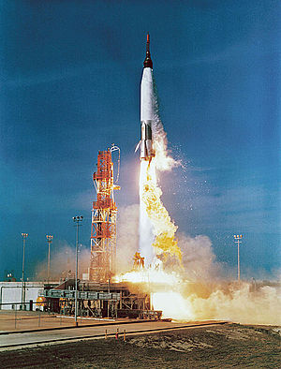
Integration
However, highly integrated designs tend to require a lot more design effort, have more complex failure modes, and require special handing and maintenance
Consider the Atlas ICBM
The Atlas has “balloon tanks”
The fuel tanks are very thin and flexible, like balloons
Unlike most other rockets, the tanks must always be pressurized, otherwise they collapse
Tanks fulfil both a fuel storage function and a structural function
Balloon tanks allow much lighter construction
However, the pressurization issue makes them so problematic that they’re not used anymore

Slide 4
Integration
Our robots tend to be very “tightly” integrated
Many control system components built into the superstructure
Electronics bolted to bellypan, then wired together
Many structural components also serve as wire management
Try swapping the PDP on the 2019 bot…

Slide 5
Modularity
What is modularity?
Composition becomes more hierarchical
Instead of a robot made of components, the robot is made of subsystems
Subsystems are independently designed, built, and tested before being assembled into “the robot”

Slide 6
Modularity
Subsystems should be well encapsulated (software engineering term)
“Things outside the boundary don’t affect things inside the boundary”
Things outside the boundary only need to care about the interface

Slide 7
Example
We (JPL) are building a spacecraft, and we want to put a camera on it
We contract out the design & manufacture of the camera
But how do we make sure the camera will work correctly with the rest of the spacecraft?
We agree on the interfaces, in the form of an ICD (Interface Control Document)
Akin’s Law #15: The ability to improve a design occurs primarily at the interfaces. This is also the prime location for screwing it up.

Slide 8
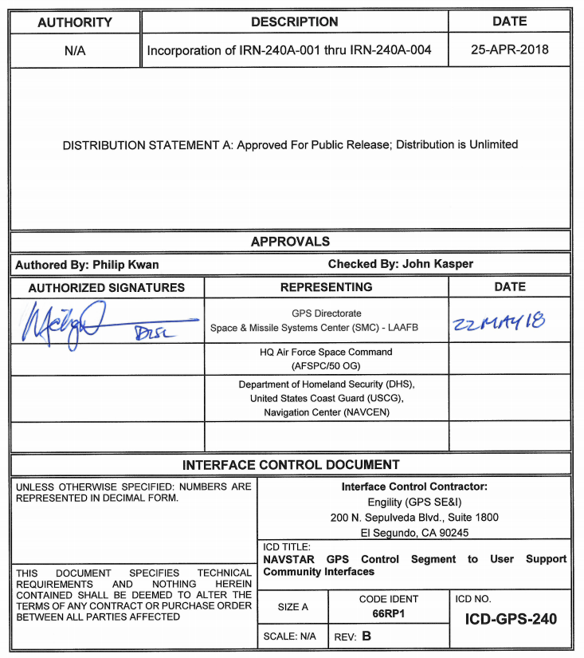

Slide 9
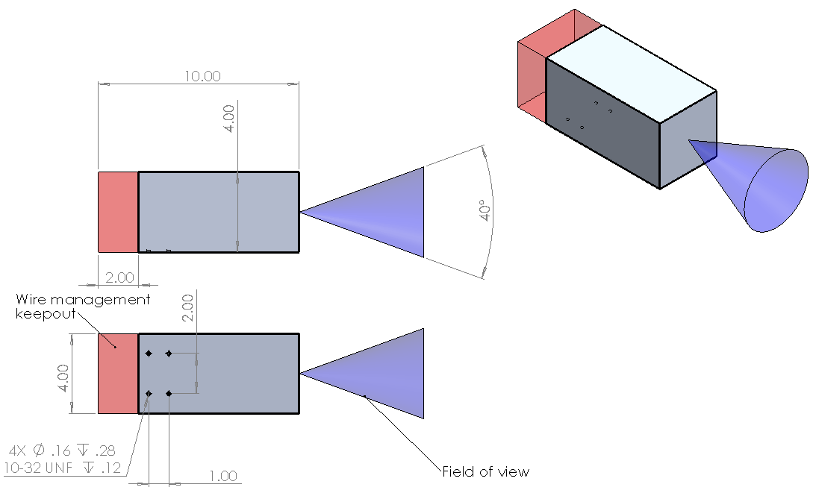
Example
Mechanical ICD (MICD)
Mass
Center of mass
Envelopes

Slide 10
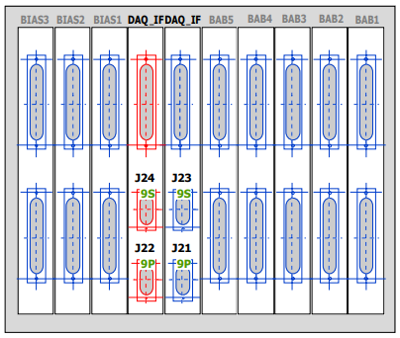
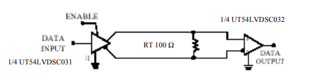
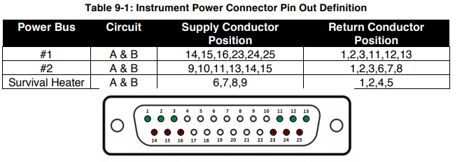
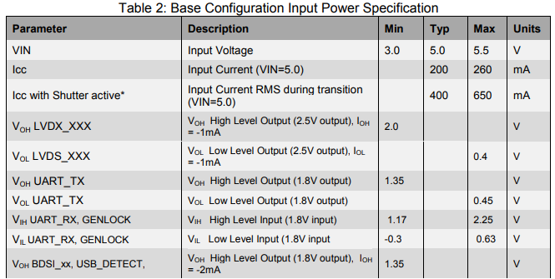
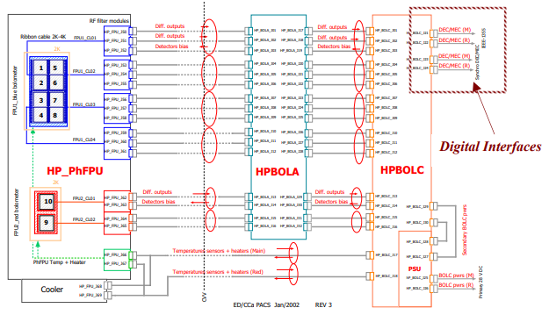
Example
Electrical ICD (EICD)
Power requirements
Connectors & pinouts
Data transfer (Ethernet, serial, etc.)

Slide 11
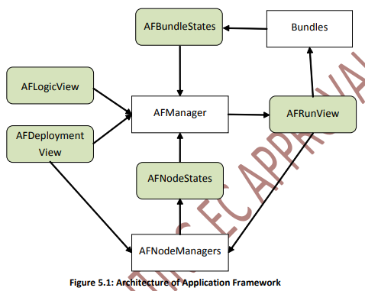
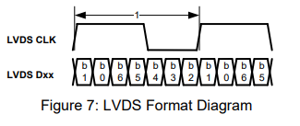
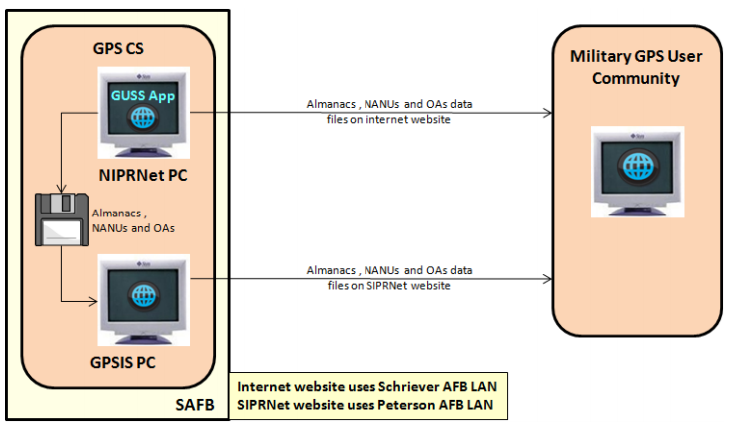
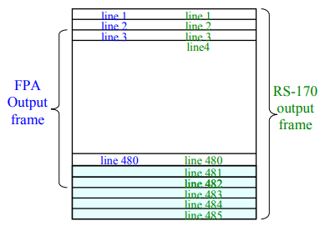
Example
Communications (programming)
Command dictionary
Data encoding
State diagrams

Slide 12
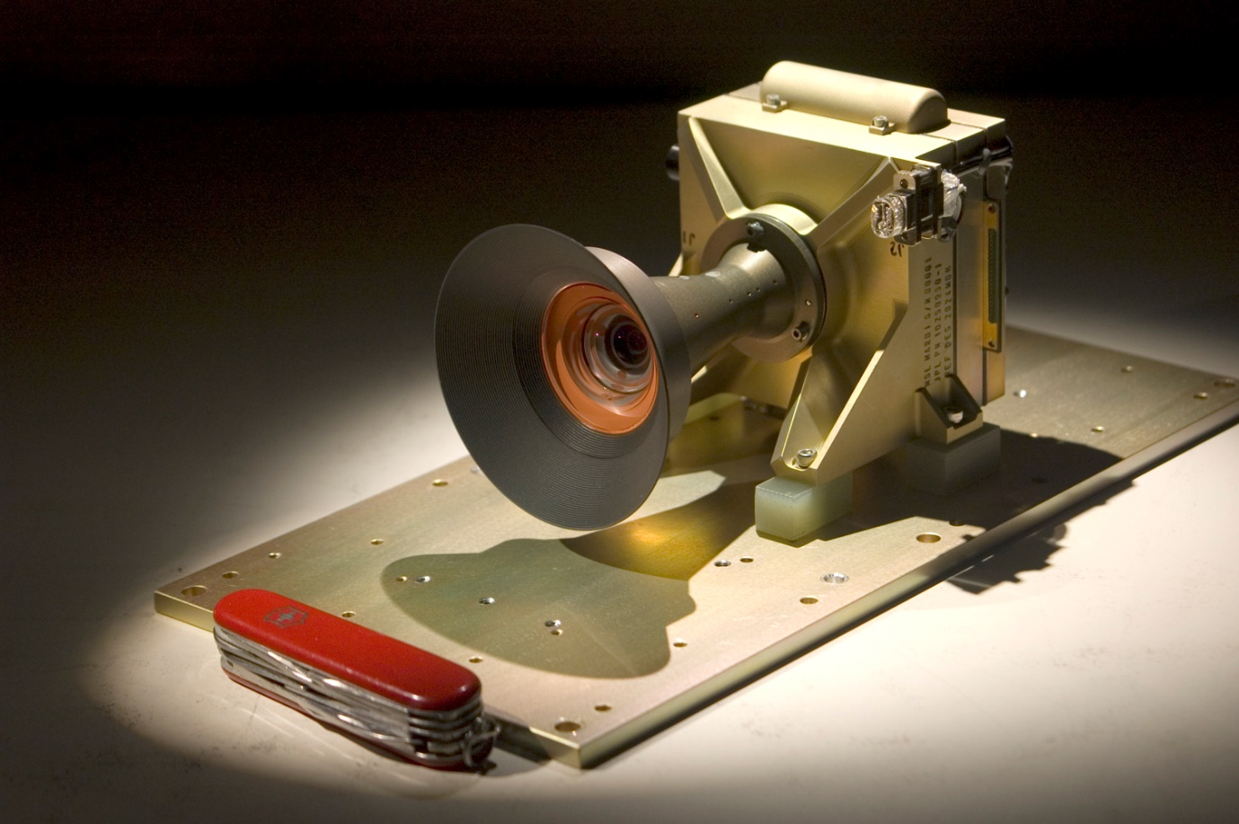
Example

Slide 13
Results
Thanks to a bilateral ICD, the contractor was designing, building, and testing the camera while we were designing, building, and testing the spacecraft
When the contractor delivers the camera:
We bolt it onto the mount we’d already made
We plug in the connectors we’d already wired
We run the software we’d already written
Since the spacecraft complies with the ICD, and the camera complies with the ICD, they should work together after being tested independently

Slide 14
Modularity
Modular systems also allow the concept of line-replaceable units
Aviation term
Modular components that can be replaced on the flightline (an aircraft parked out on the tarmac, rather than in the shop)
No one is ever leaning into a spacecraft or an airplane with a soldering iron
Everything is packaged into “boxes”, which can be easily disconnected and replaced with an identical box

Slide 15
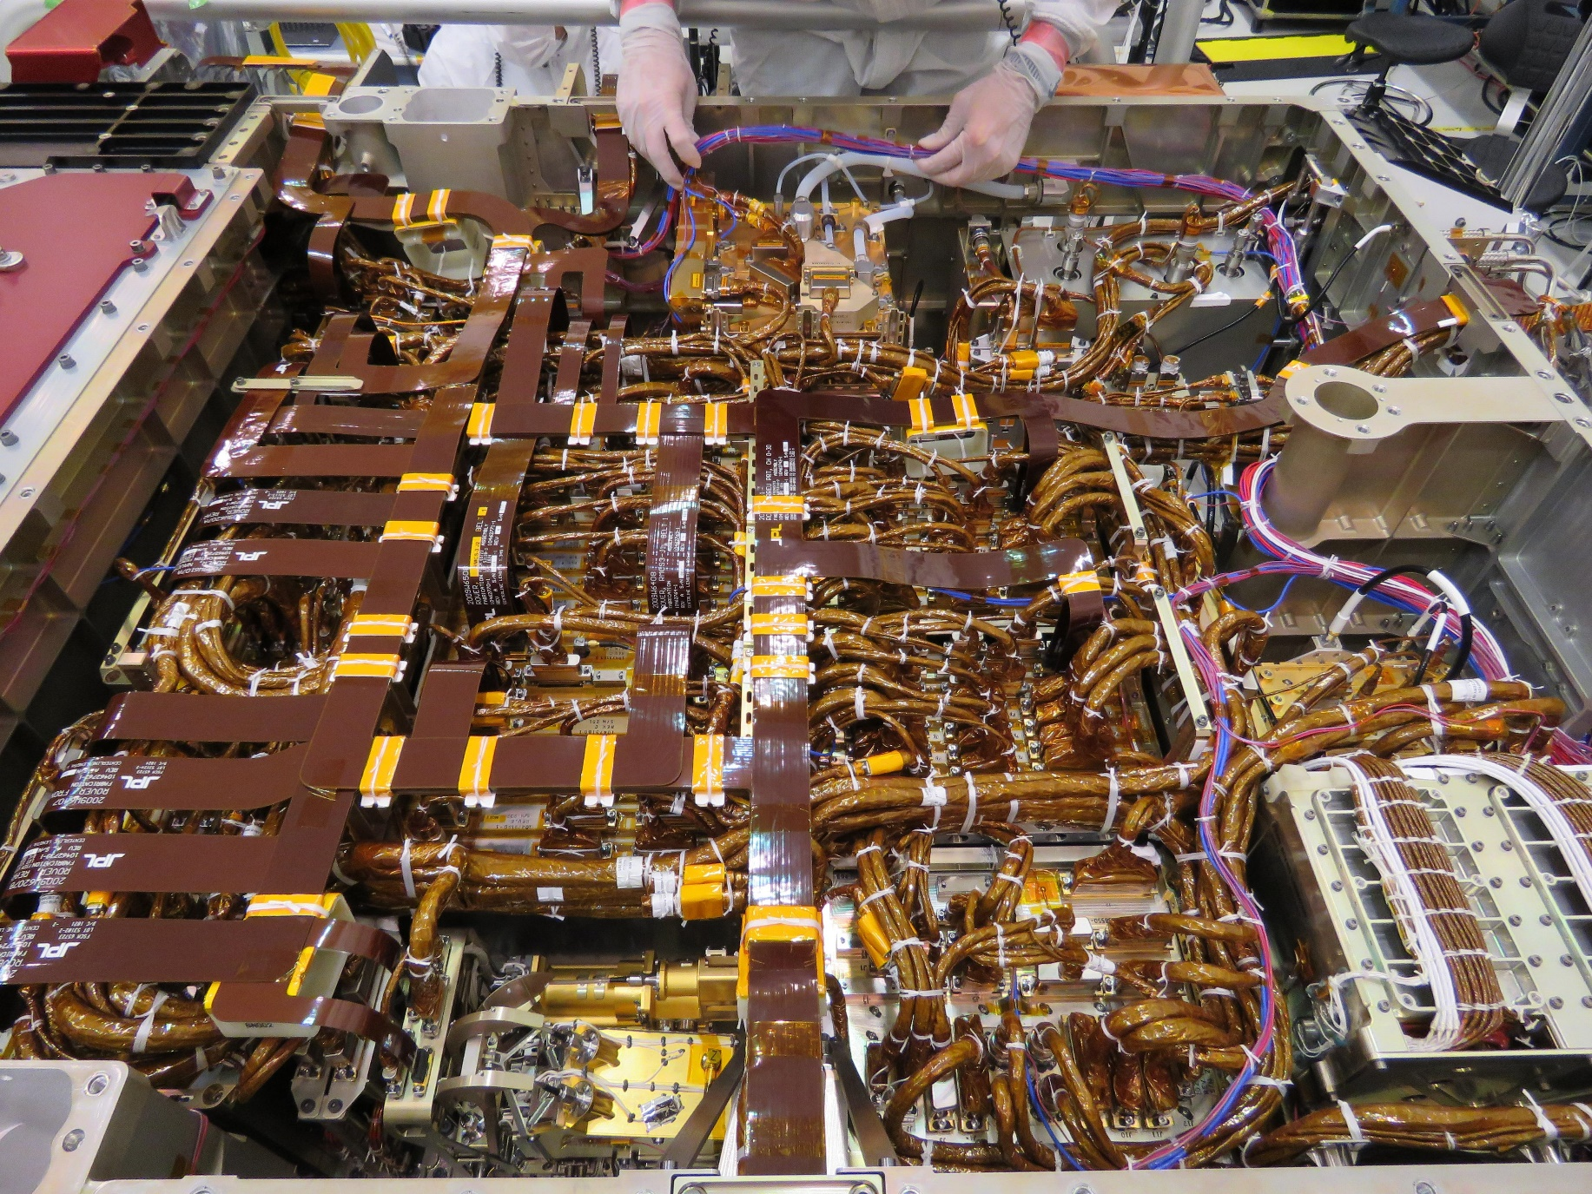

Slide 16
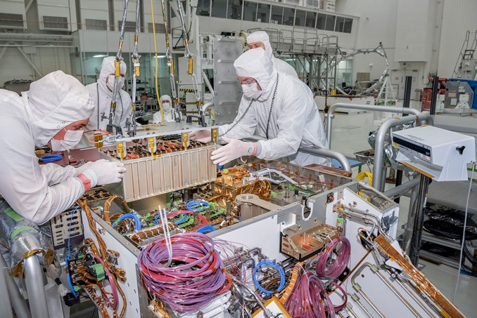

Slide 17
Modularity & Integration
Modularity and integration are not contradictory
Modularity just requires that your “tight” integration be at the subsystem level, rather than the system level
Subsystems might be complex and tightly-integrated, but their interfaces are well-defined

Slide 18
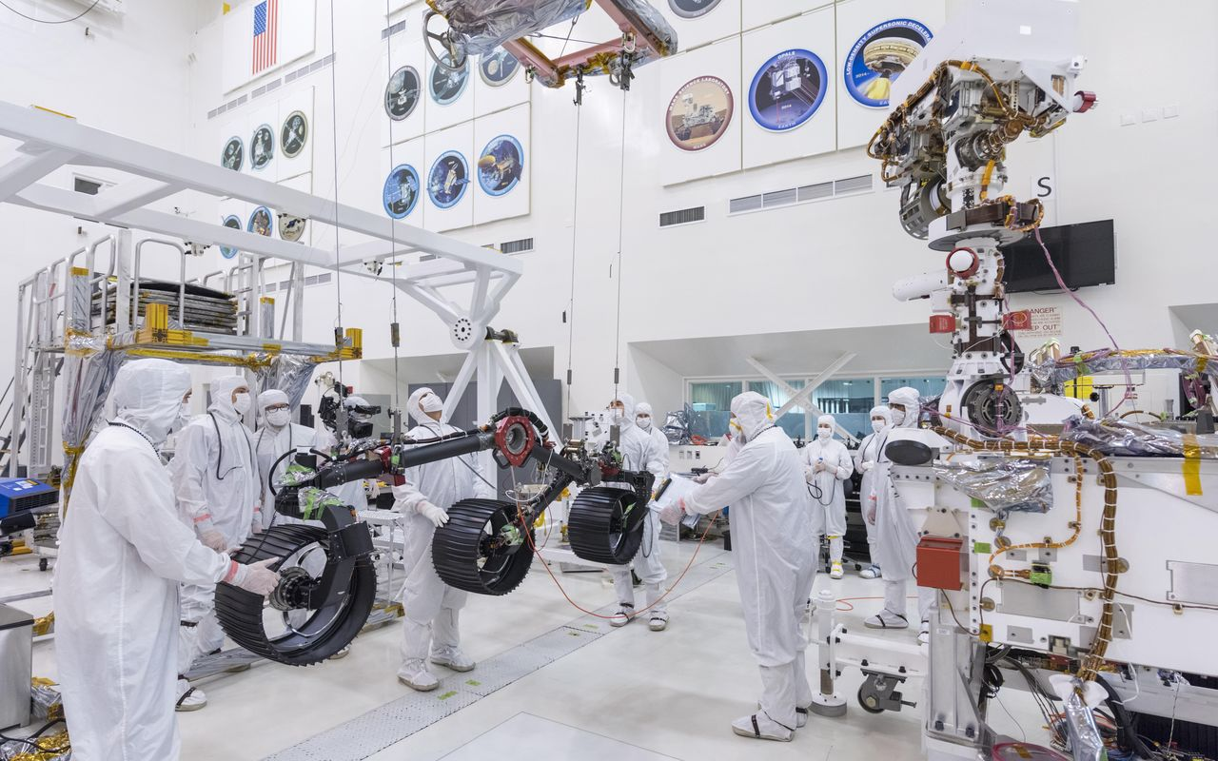

Slide 19
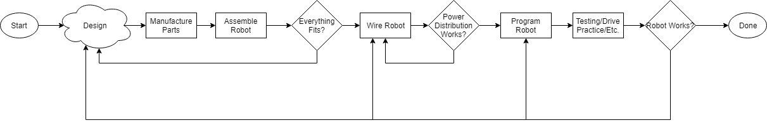
Process Flow

Slide 20
Problems With “Waterfall” Process
Allows a high level of integration, because the entire robot is being designed in one process
Introduces dependencies between processes
Can’t make sure WiFi works until robot is wired, which can’t happen until robot is assembled
Boom-and-bust workload for subteams
The control system team can’t start programming the robot until the robot is mostly done
Applies to manufacturing, to a more limited extent

Slide 21
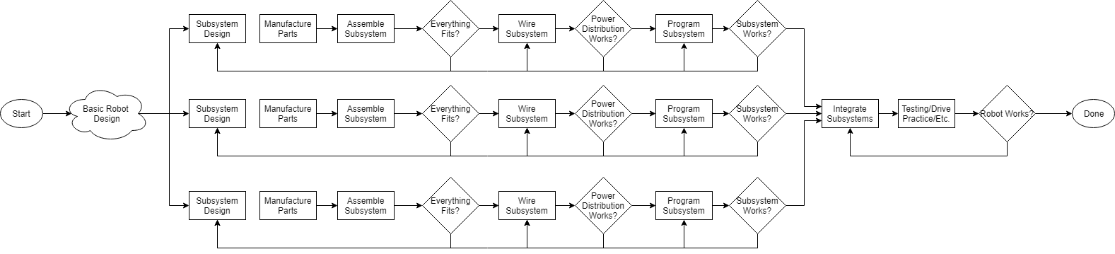
New Process Flow

Slide 22
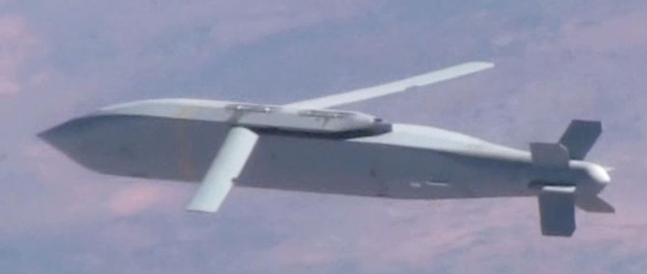
JSOW
Joint StandOff Weapon
“…JSOW was considered to be one of the most successful development programs in DOD history...”
“…introduced to operational use a year ahead of schedule.”
“…never had a weight management problem, and was deployed at its target weight.”
“…was able to obtain authority from an independent safety review in record time.”
Quotes from Wikipedia

Slide 23
JSOW
“The program staff was organized into integrated product teams with members from the government, the prime Texas Instruments and subcontractors.”

Slide 24
Conclusion: Modularity
Advantages
Parallel development
Easier service
Reusable modules
Better testing
Disadvantages
Less efficient design
How?
Define interfaces
Integrated product teams

